Slide 1


“Leadership for the Long Run”
Jody Davis
Director of University Recreation
Coastal Carolina University

Slide 2

Typical Topics of Enduring Leadership
  Find a mentor.
  Be Willing to change.
  Become a constant learner.
  Maintain a work/life balance.
  Set goals (short-term and long-term).
  Take care of details.

Slide 3
NIRSA Student Vote Bylaw Amendment
Proposed language
  Student Members There shall be one class of student members who shall be entitled to vote in all matters subject to vote by the membership, except for the professional regional positions on the Member Network. Student membership shall be available to graduate and undergraduate students interested in recreation, intramural and/or wellness programming upon application and payment of the then-designated membership fee. Student members shall have no voting privileges except for the election of the Student Leadership Team. Student members may attend membership meetings.

Slide 4
NIRSA Student Vote Bylaw Amendment
Rationale:
  In 2019-2020 the Member Network had a work team assigned to review the Code of Ethics. At the time NIRSA, had separate codes for students and professionals.
    Benchmarked against codes from many organizations, it was noticed they did not have a separate code for students. The question then is what is the rationale for holding students to a separate standard for conduct.
    In the end, it was concluded that continuing with a separate code for students and professionals was not in keeping with NIRSA’s student development values.
    Since participating in that work, it has been noticed that the conversations around the Code of Ethics were related to the ability of students to vote. If students are held to the same standards of ethics, why wouldn’t they be allowed or seen as fit to vote?
    In the end, this change would benefit the association by increasing student member engagement.

Slide 5
NIRSA Student Vote Bylaw Amendment
Perspectives - Pros:
    Increase student member involvement and engagement.
    Fits with our values and Code of Ethics: Facilitate student development that aids in a journey to ethical, engaged, and generous citizenry.
    Student members are capable of informed and responsible participation.
    The association remains in touch with younger generational trends in the field.
    If a student pays their membership dues, why wouldn't they get to vote for bylaw amendments and the leaders of the association.
    The United States voting age is 18.
    Not all student members are traditionally aged college students or professionally inexperienced.
    Professional members do not allow representatives to vote for them, why should students?

Slide 6
NIRSA Student Vote Bylaw Amendment
Perspectives - Cons:
    Students don’t know enough to cast informed votes. This is a responsibility of NIRSA to educate members and give them the information needed to vote in the same way they do for professionals. What evidence exists that students wouldn’t be informed? Certainly member engagement exists on a spectrum and some students are more involved and informed than some professionals.
    ·Student votes would dilute the professional vote. Based on current membership totals professionals would make up approximately 86% of the vote if we included students and achieved perfect attendance on ballots. In the 2021 election, students cast 7.6% of the total ballots.
    ·Campus recreation programs at larger schools would gain more votes and influence within the association over smaller programs. Currently exists within the professional vote.

Slide 7
NIRSA Student Vote Bylaw Amendment
Perspectives - Cons:
  Students’ votes could be influenced by other members (possibly the director of their department). Potential abuse of power imbalances would not be unique to students and would be in violation of our fairness and integrity sections of the NIRSA Code of Ethics.
  Students do vote by representation through student Member Network reps. Eight students make up 1-2% of the student membership and do not sufficiently represent the views and interests of all student members.
  They don’t pay equal membership fees. Membership rates are market driven and the student discount is strategic (mission critical) for recruitment into the association for the health and fortification of our profession. The dues paid are not indicative of a level of care of the association.

Slide 8
NIRSA Student Vote Bylaw Amendment
Background information:
  Membership averages Jan-May 2019: 3,140 professionals & 1,147 students
  Jan-May 2021: 2,537 professionals & 429 students
  Over the past 10 years, approximately 14% of students become professional members
  History of similar amendment proposals with Bylaws committee, Board, and Association: This bylaws amendment has never been voted on by the association, the topic has been discussed but never had an amendment submitted.

Slide 9
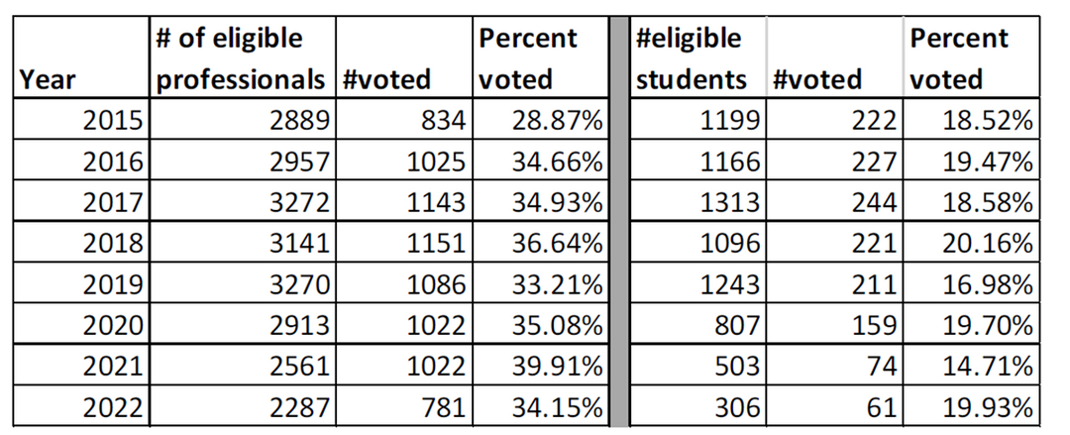
NIRSA Student Vote Bylaw Amendment

Slide 10
Future Conversations
  Connect Forum
  Ideas in Motion Virtual Conversation: October 25th 12pm EST
    NIRSA Learning - https://learning.nirsa.org/products/nirsa-bylaws-town-hall

Slide 11
Thank you!
Don’t forget to complete your feedback survey in Pheedloop! This is very beneficial to us as we develop this presentation for the future.

